Slide 1


Slide 2


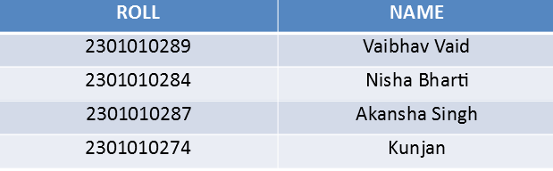
KITCHEN KART
Second Year Project Synopsis
Submitted by
Industry Mentor:
Faculty Mentor: Dr . Vandana Batra
Notes:
New Courses replaced with New Programmes
<number>

Slide 3
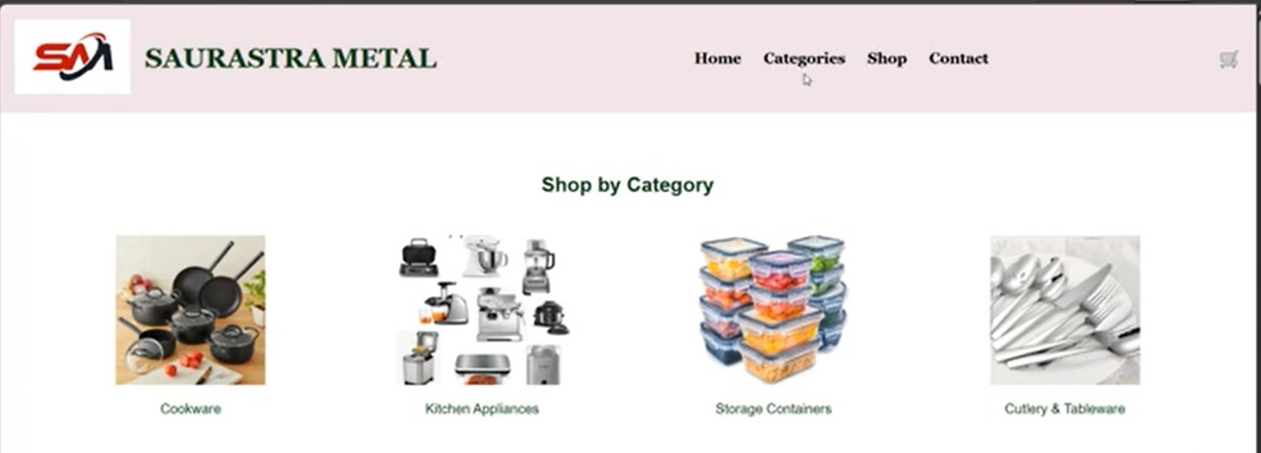

Project Overview
Kitchen Kart is an innovative e-commerce platform designed to offer a wide variety of home and kitchen appliances. With a focus on convenience, quality, and customer engagement, Kitchen Kart aims to transform how households shop for their kitchen essentials.
Notes:
<number>

Slide 4
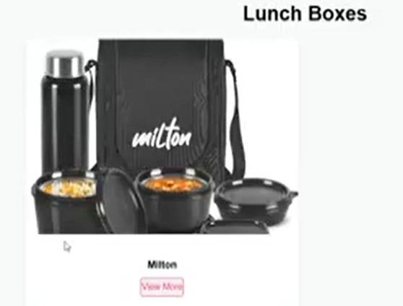
Solution of the Problem
Kitchen Kart bridges the gap with:
A specialized catalog for kitchen/home products after adding more details button
Easy navigation and search filters are also given for the users to search for the particular product
Secure and smooth checkout by giving add to Cart Option and a payment gateway
Admin dashboard for product & order management
Notes:
<number>

Slide 5
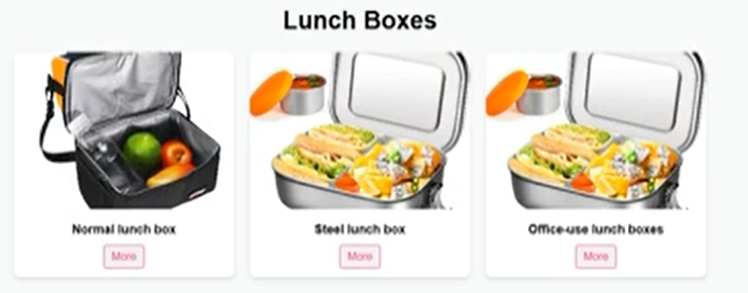
Key Features:
User Registration & Login
Product Search and Filtering
Product Detail Pages with Ratings
Secure Cart and Checkout
Responsive Design

Slide 6
Challenges & Resolutions:
Challenges Faced:
Integrating secure payment options
Maintaining product data structure
Making the design mobile-friendly
How We Solved Them:
Used secure gateways / mock integration
Applied responsive grid and card layouts
Refactored code and tested iteratively

Slide 7
IMPLEMENTATION SCREENSHOT:

Slide 9
Objectives
Establish a strong online presence.
Provide a secure and efficient e-commerce platform.
Ensure a user-friendly experience with intuitive navigation.
Integrate analytics to monitor customer behavior and sales.
Notes:
<number>

Slide 10
Methodology, Tools, and Techniques
Methodology: Agile development for iterative improvements.
Tools: HTML, CSS, JavaScript, and backend frameworks.
Techniques: SEO optimization, responsive design, and secure payment integration.
Notes:
<number>

Slide 11
Project Timeline
Phase 1: Planning and Requirement Gathering (2 weeks)
Phase 2: Design and Development (6 weeks)
Phase 3: Testing and Quality Assurance (2 weeks)
Phase 4: Deployment and Maintenance (Ongoing)
Notes:
<number>

Slide 12
Expected Results & Outcomes
Expected Results:
Enhanced customer experience.
Increased sales and brand reach.
Better inventory management.
Outcomes:
Functional and tested e-commerce website
Positive user feedback on interface
Fully operational admin dashboard
Improved understanding of full-stack development
Notes:
<number>

Slide 13
Future Scope:
Integration with real payment gateways
Customer reviews and wishlist
AI-based product recommendations
Mobile app version

Slide 14
References
1. Research Articles on E-commerce Trends
Google Scholar (https://scholar.google.com/)
IEEE Xplore (https://ieeexplore.ieee.org/)
ResearchGate (https://www.researchgate.net/)
2. Industry Reports on Home and Kitchen Retail
Statista (https://www.statista.com/)
IBISWorld (https://www.ibisworld.com/)
McKinsey & Company (https://www.mckinsey.com/)
3. Website Development Best Practices
MDN Web Docs (https://developer.mozilla.org/)
W3C (https://www.w3.org/)
Smashing Magazine (https://www.smashingmagazine.com/)
Notes:
<number>

Slide 15
THANK YOU

